Slide 1
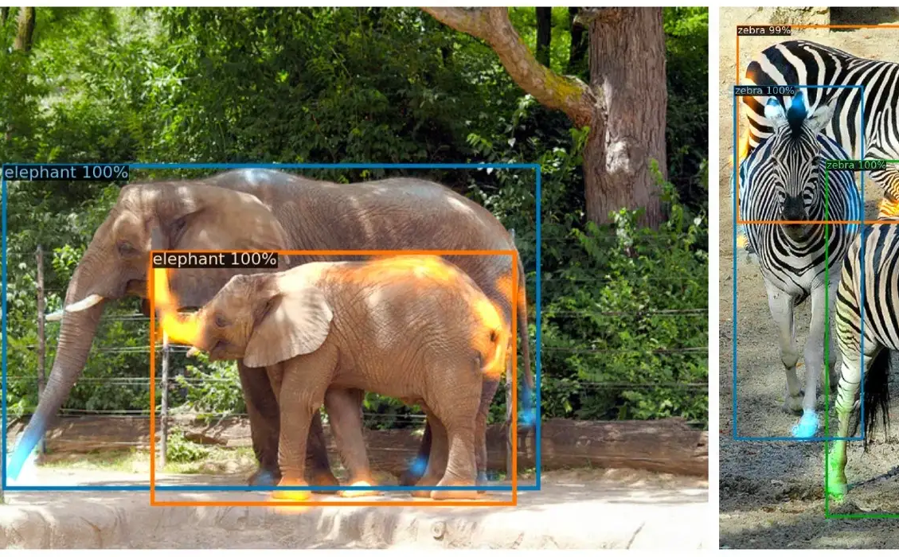
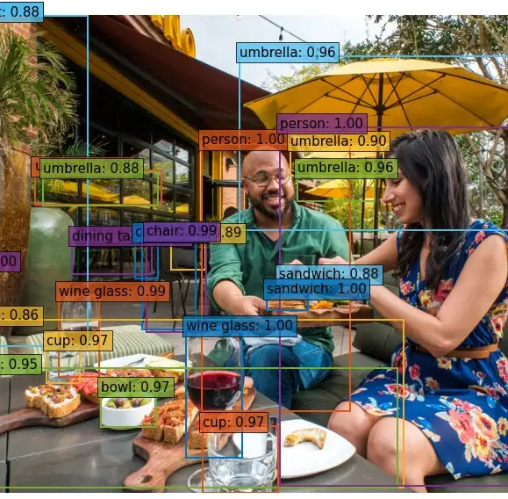
End-to-End Object Detection with Transformers
Irimia Elena-Larisa

Slide 2
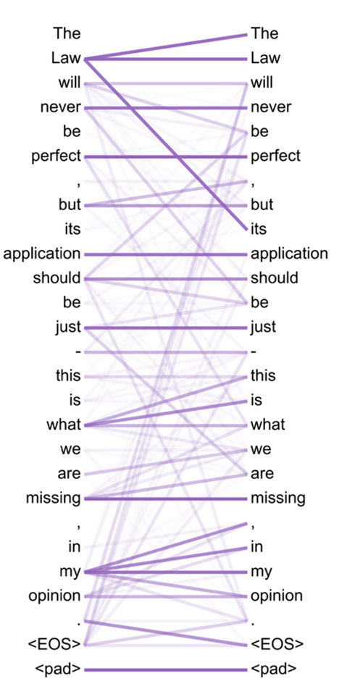
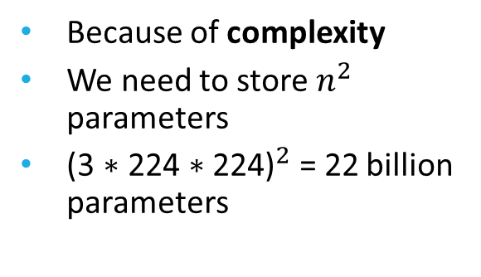
1. CONTEXT
WHY DON'T WE USE A FULL IMAGE FOR TRANSFORMER?
Vaswani et al. [2]

Slide 3
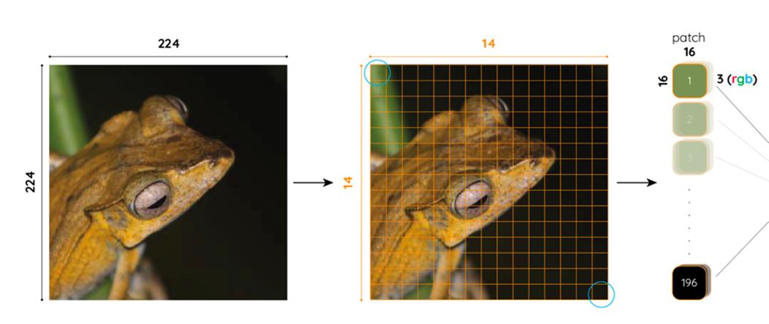
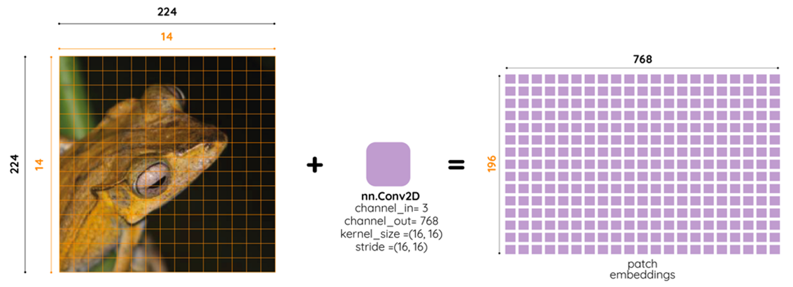
PATCH EMBEDDINGS in vision transformer
Image of size (3,244,244)
Divided into 196 (14 ∗ 14) patches of size 3 ∗ 16 ∗ 16
D16 ∗ 14 = 224 (original image size)
So after that, we have 196 vectors of size 768, a matrix of size (196,768)
Each patch is converted into a vector of size 3 ∗ 16 ∗ 16 = 768

Slide 4
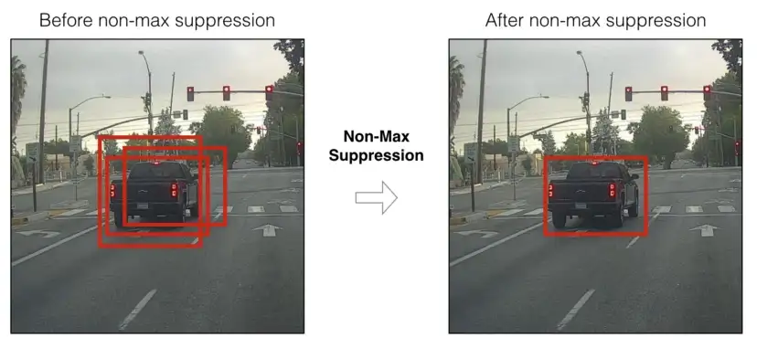
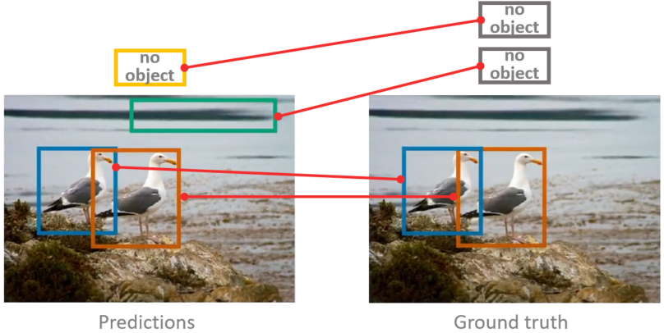
2. DETR
DETR (Detection Transformer) treats an object detection problem as a direct set prediction problem with the help of an encoder-decoder architecture based on transformers
Uses bipartite matching between predicted and ground truth objects which ensures one-to-one mapping between predicted and ground truth objects/bounding boxes

Slide 5
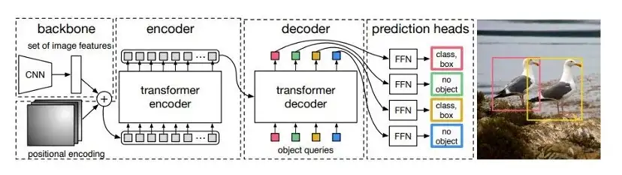
3. the architecture model
Two things are essential for direct set predictions in detection:
A set prediction loss that forces unique matching between predicted and ground truth boxes
An architecture that predicts (in a single pass) a set of objects and models their relation
Carion et al. [1]

Slide 6
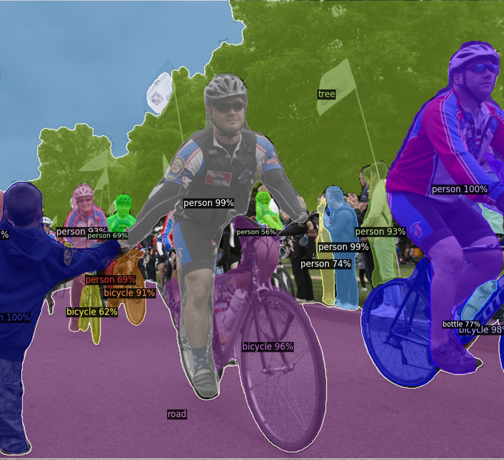
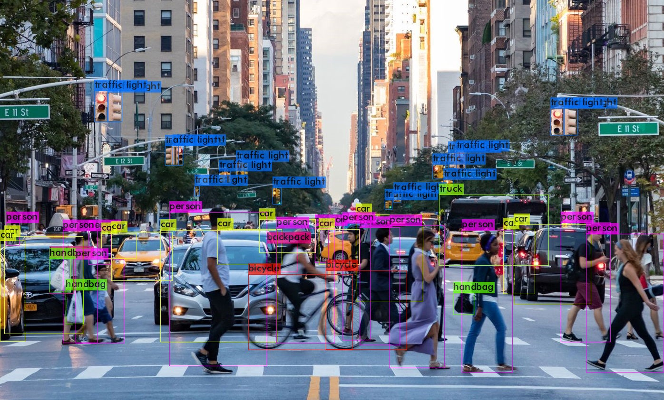
5. CONCLUSIONS
Vision Transformers are still a recent topic in the Computer Vision discipline
Such networks have achieved more highly competitive performance than CNNs in Object Detection task
There is an important constraint that makes their application rather challenging, the need for large datasets

Slide 7
REFERENCES:
[1] Carion, N., Massa, F., Synnaeve, G., Usunier, N., Kirillov, A., Zagoruyko, S., 2020. End-to-end object detection with transformers, in: Vedaldi, A., Bischof, H., Brox, T., Frahm, J. (Eds.), Computer Vision - ECCV 2020 - 16th European Conference, Glasgow, UK, August 23-28, 2020, Proceedings, Part I, Springer. pp. 213–229. URL: https://doi.org/10.1007/978-3-030-58452-8_13, doi:10.1007/978-3-030-58452-8\_13.
[2] Vaswani, A., Shazeer, N., Parmar, N., Uszkoreit, J., Jones, L., Gomez, A.N., Kaiser, L., Polosukhin, I., 2017. Attention is all you need, in: Guyon, I., von Luxburg, U., Bengio, S., Wallach, H.M., Fergus, R., Vishwanathan, S.V.N., Garnett, R. (Eds.), Advances in Neural Information Processing Systems 30: Annual Conference on Neural Information Processing Systems 2017, December 4-9, 2017, Long Beach, CA, USA, pp.59986008. URL:https://proceedings.neurips.cc/paper/2017/hash/3f5ee243547dee91fbd053c1c4a845aa-Abstract. html.

Slide 8

Thank you for your attention!

